Slide 1
PROPERTY MANAGEMENT APPLICATION USING FOR SALESFORCE

Slide 2
1.INTRODUCTION:
One of the Onsite Property Manager “property management software can increase the income of your property is by automatically calculating and posting rents and late fees at the times you specify.
You and your property management staff will be able take a firm stand on late fees now that they are “In The Computer” and can no longer be excused. Most members report increased profits from their properties from just this one feature alone.
The property manager software allows you to move in tenants at any time of the month and it automatically calculates the move in charges including pro-rating the rent.
PURPOSE:
Being a cloud-based CRM platform, salesforce rental management helps you keep a track of all your tenants and buyers on a single platform. Enterprise-level platform security that improves with each release. Infinite customizability of the system. Data integration of various data sources.

Slide 3
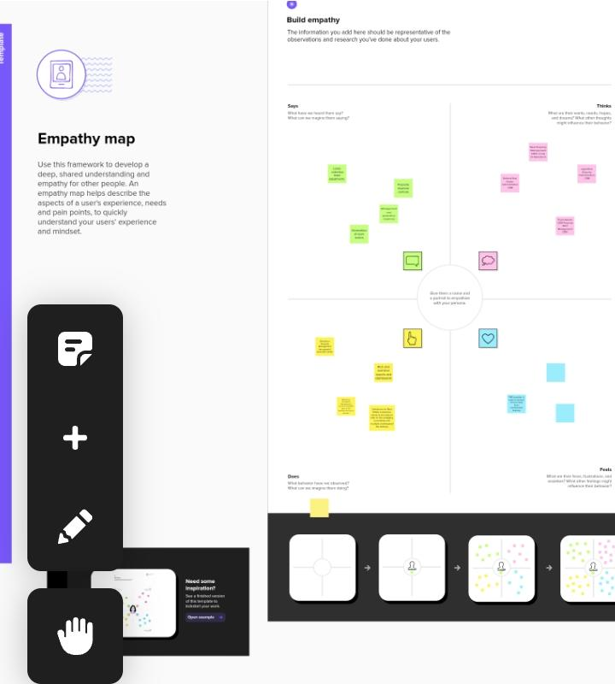
2. Problem Definition & Design Thinking
2.1. Empathy Map

Slide 4
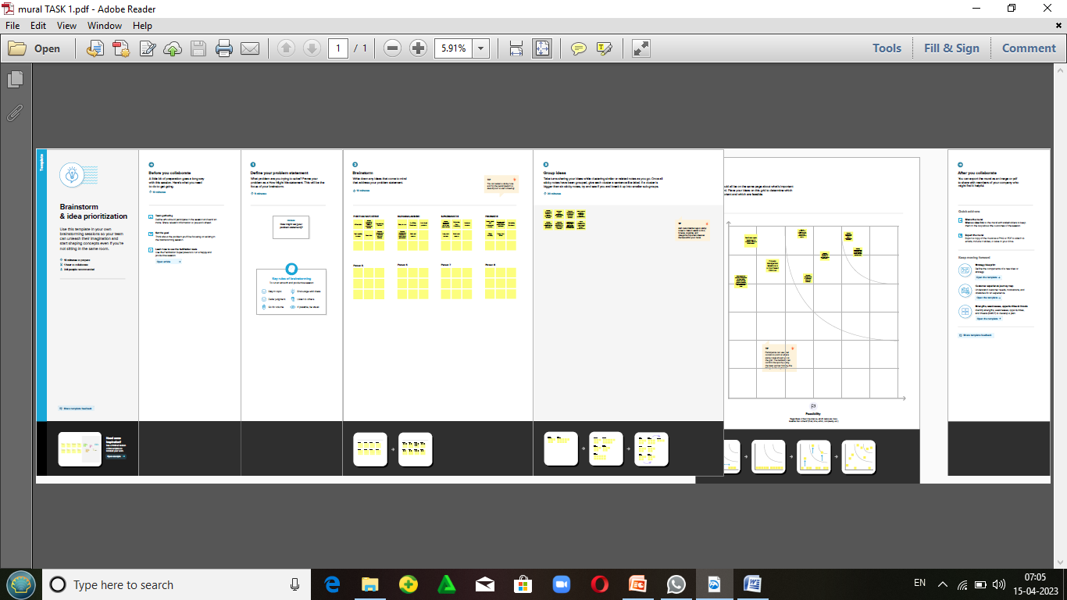
2.2. Ideation & Brainstorming

Slide 5
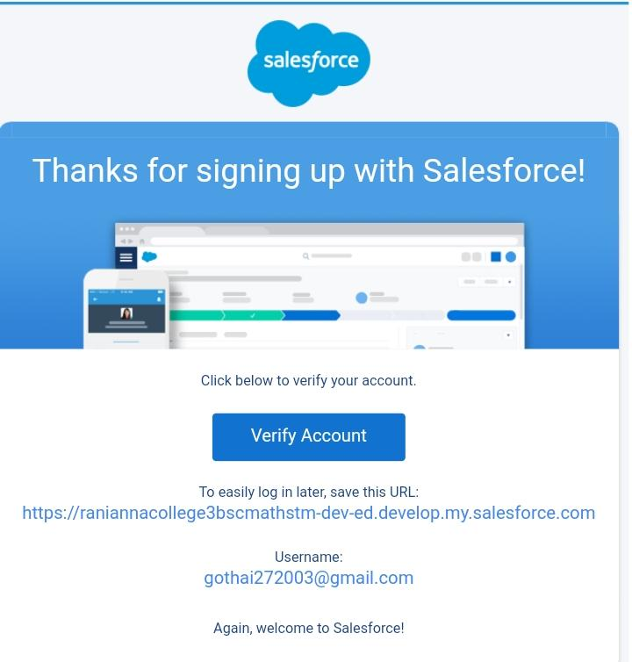
3.2. Activity & Screenshot Creating Developer Account:
Using this https://developer.salesforce.com/ link we signup the salesforce platform and finally we get the verification mail that shown in the above figure

Slide 6
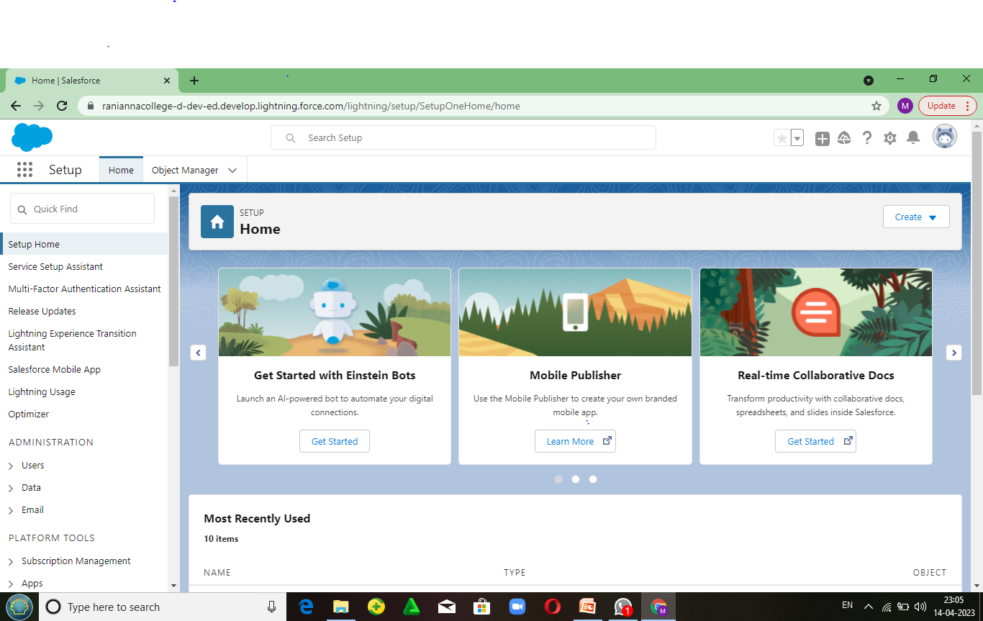
Salesforce Login:
. https://login.salesforce.com/ we used this link to login the salesforce platform. This link asked our usernameand password only

Slide 7
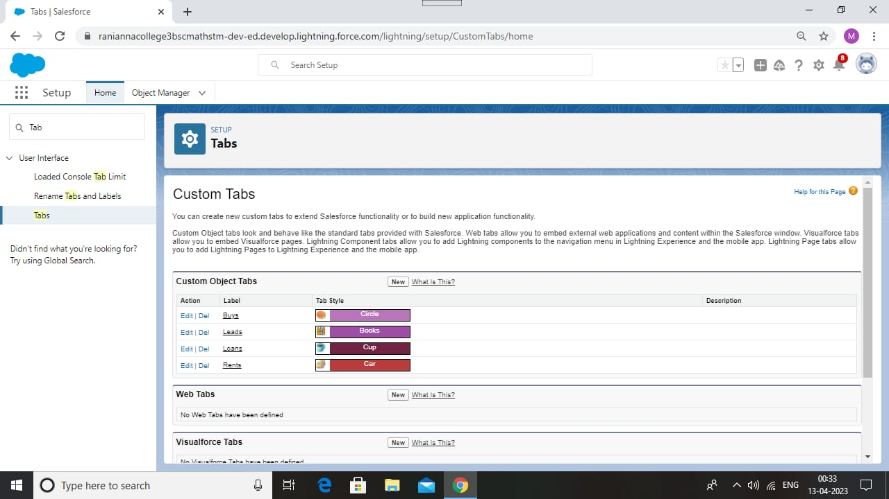
Object:

Slide 8
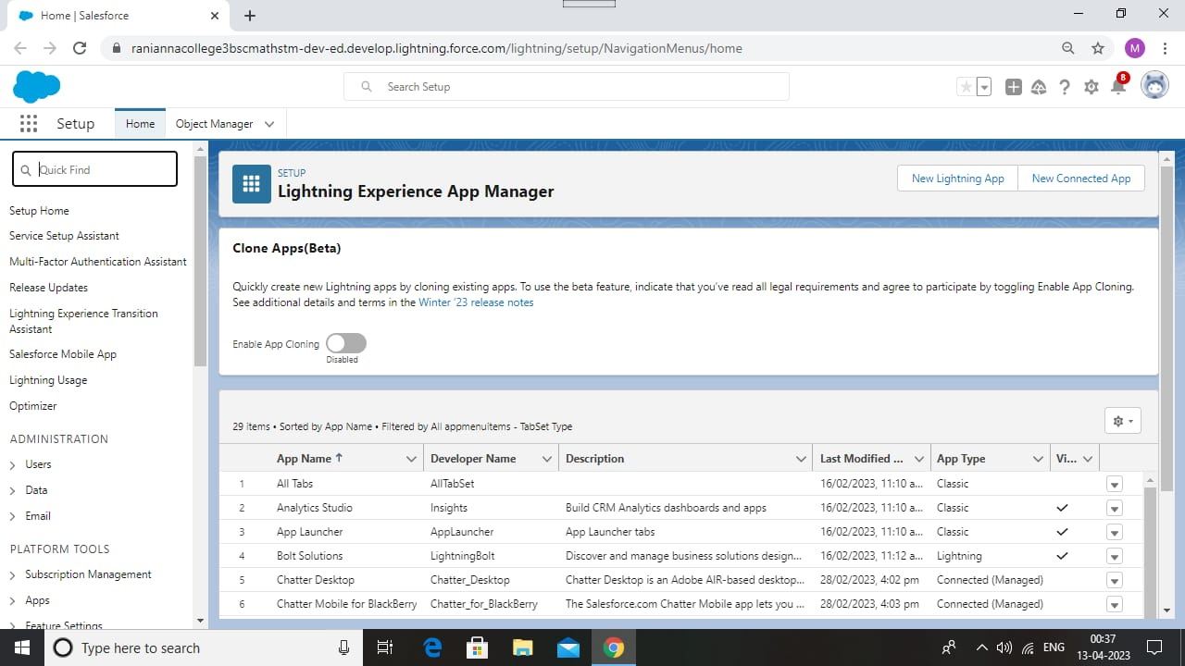
Lightning App:

Slide 9
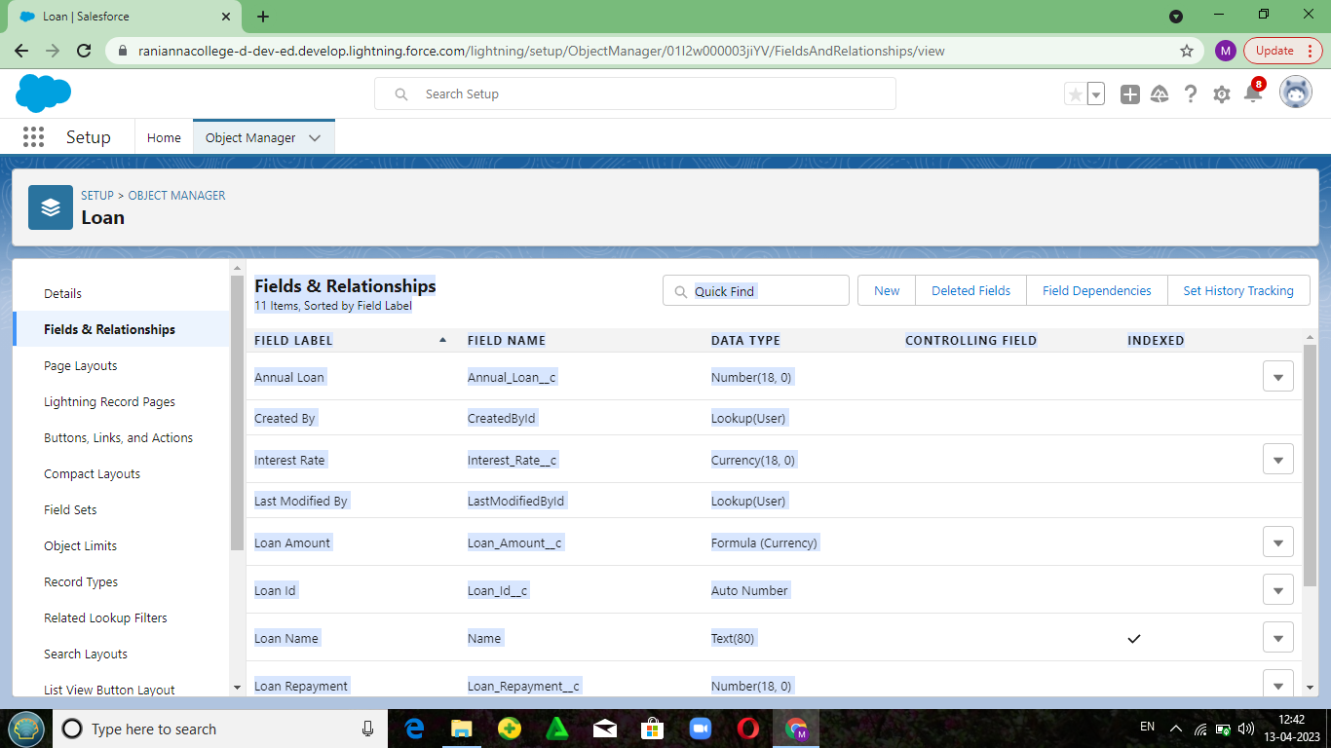
Fields and Relationship

Slide 10
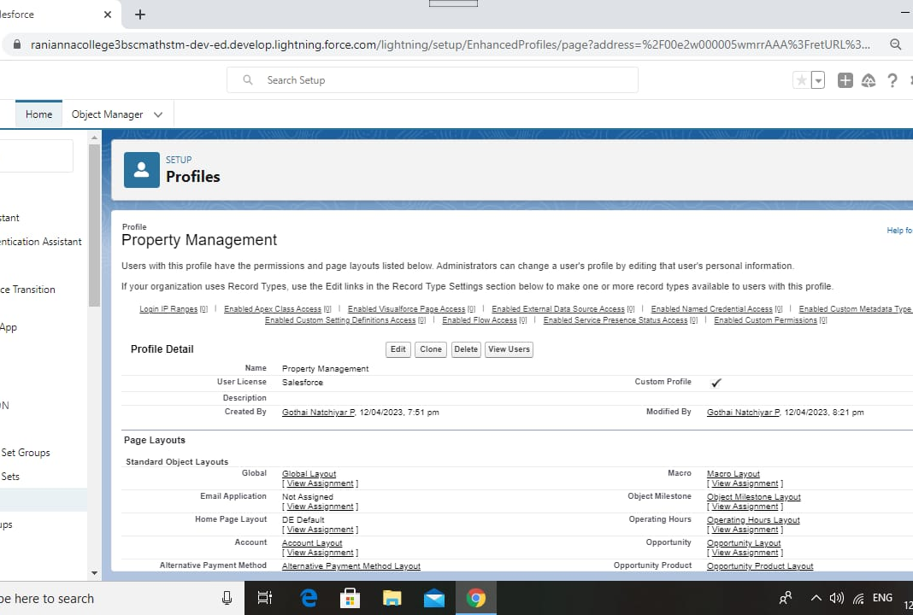
Profile:

Slide 11
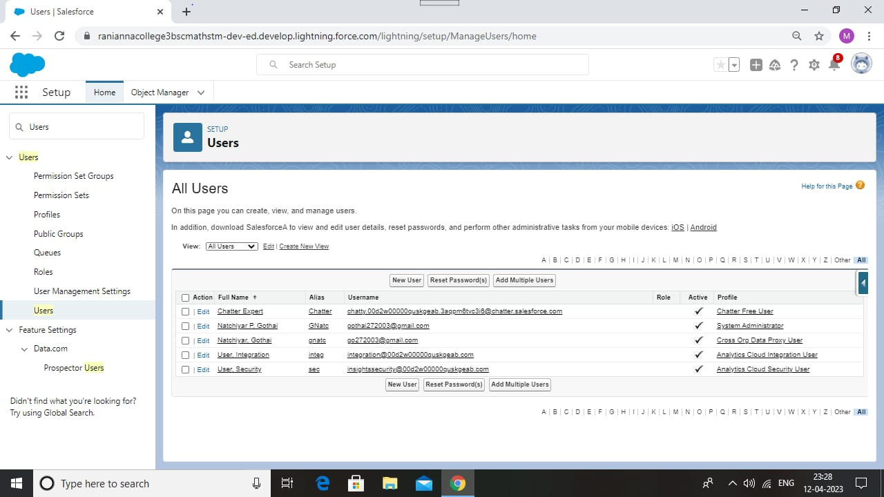
Users:

Slide 12
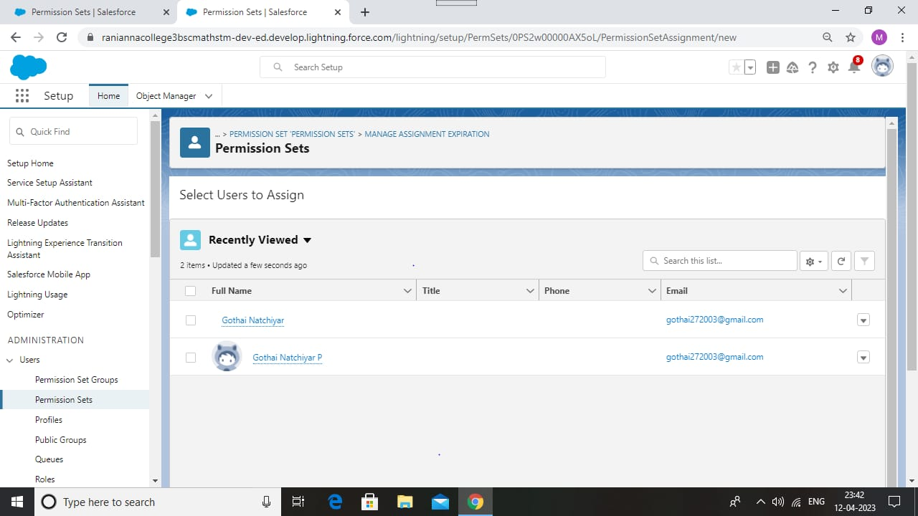
Permission Sets:

Slide 13
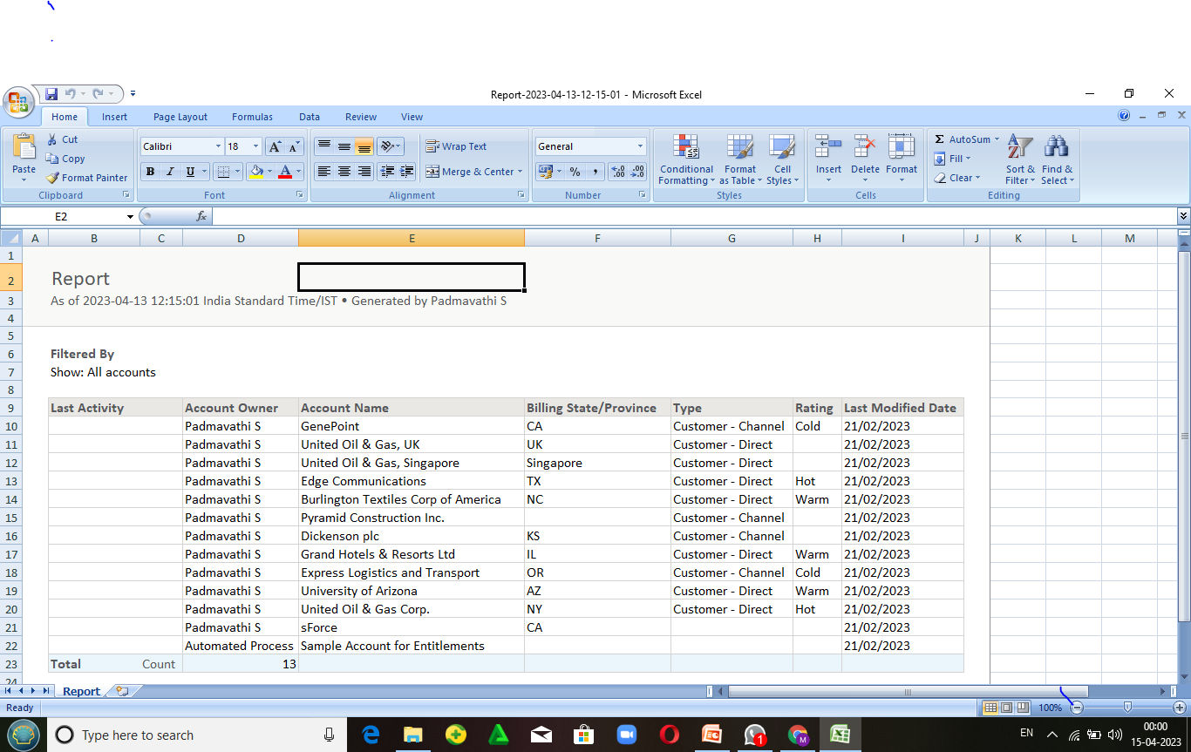
Reports:

Slide 14
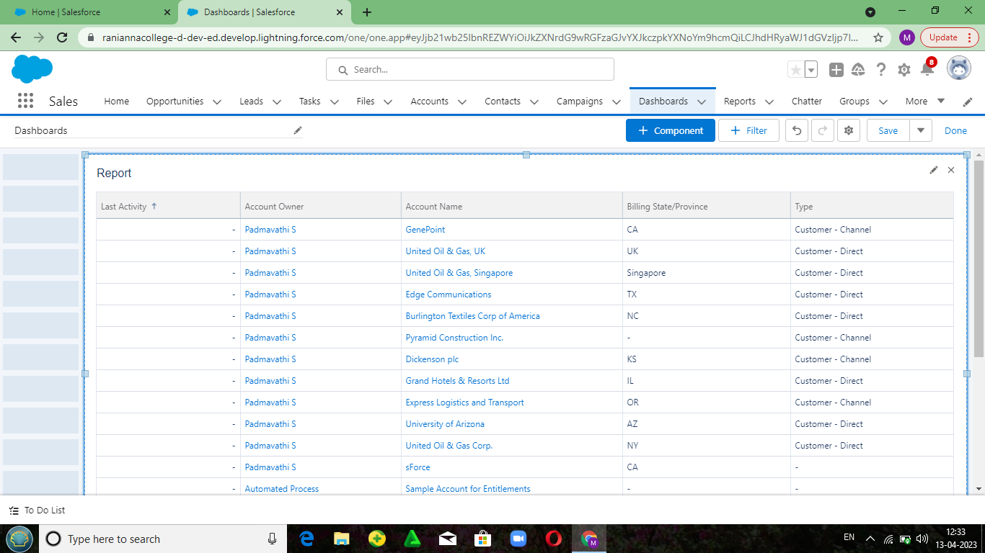
Dashboards:

